Slide 1

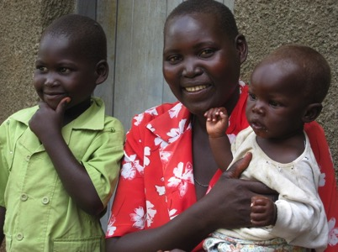
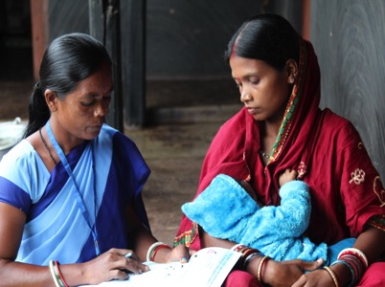
Anemia—An Overview
Notes:
This presentation will be general overview of Anemia, and includes the information on the causes and consequences of anemia, a description of anemia as a global health problem, and interventions to address anemia.

Slide 2
What is Anemia?
Anemia / Anaemia—Greek word anaimía “want of blood”
Red blood cells (RBC)—transport oxygen from the lungs to cells
RBCs contain a protein called hemoglobin that carries the oxygen
No/less oxygen = disrupts body functions
Slide 2
Notes:
Anemia is a condition characterized by low levels of hemoglobin concentration or red-cell count.
Hemoglobin is the protein in red blood cells that carries oxygen from the lungs to the rest of the body, where it is needed for essential body functions.
If hemoglobin is low, it causes impairment in meeting the oxygen demands of body’s tissues, and can thus result in negative health consequences.
Anemia is a major public health problem across the world.

Slide 3
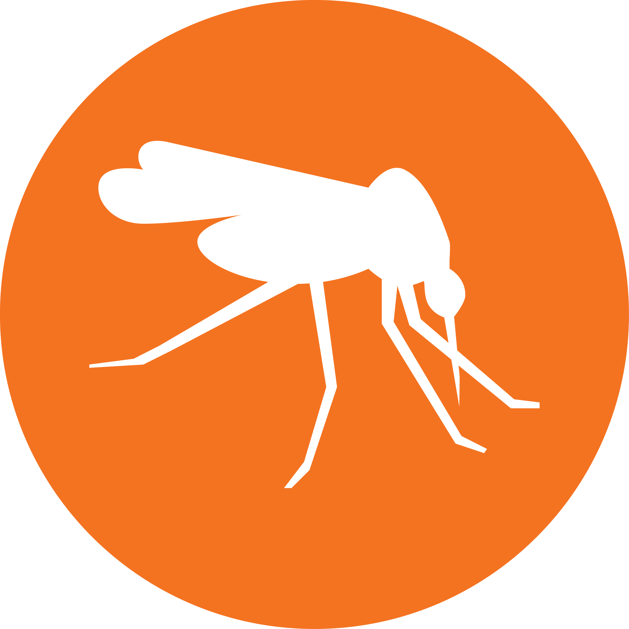

Causes of Anemia
Deficient diet: Iron, Vit. A, Zinc, Folate, Vit. B12
Malaria: ⬆ destruction & ⬇ production of RBC
Helminths: Internal bleeding (loss of iron)
Genetics: Thalassemias, sickle cell, Hb-E, Hb-C ⬆ destruction & ⬇ production of normal RBC
Inflammation: Common chronic infections
Slide 3
Cook, et al. 1994; Scott et al. 2007; Selhub et al. 2009; Ganz et al. 2011; George, et al. 2012; Pasricha et al. 2010; Suchdev et al. 2012
Notes:
Anemia is a caused multiple factors that can be grouped into four major categories: deficient diet (micronutrient deficiencies), infections (especially malaria and helminths), genetic blood disorders, and inflammation.
Diet/nutritional deficiencies, result from an inadequate intake or absorption of micronutrients needed to produce and synthesize red blood cells. Deficiencies in iron, vitamin A, zinc, folate, and vitamin B12 can directly or indirectly cause anemia through various mechanisms, including inhibition of red blood cell production, poor absorption or excessive loss of these vitamins/minerals, and increased risk and severity of infections.
Malaria: Malaria causes anemia by destroying red blood cells and decreasing the production of new red blood cells, which also leads to iron deficiency, and general inflammation. Children under 5 years of age and pregnant women are at a much higher risk for contracting malaria and becoming seriously ill.
Helminths: Helminths (Ascaris, Trichuris, or hookworm), cause blood loss in the gastrointestinal system and thus interfere with the absorption of nutrients, suppress appetite, and contribute to general inflammation, which results in anemia. Hookworm is likely the main STH contributing to anemia. Schistosomiasis causes anemia through blood loss, red blood cell destruction, immune mechanisms, and general inflammation.
Genetics: Genetic red blood cell disorders—resulting in abnormalities in the function, structure, or production of red blood cells—can cause anemia. Worldwide, approximately 11 percent of anemia is attributable to genetic red blood cell disorders, including the thalassemias and thalassemia trait, sickle cell disorders and sickle cell trait, glucose-6-phosphate deficiency (G6PD), other hemoglobinopathies and hemolytic anemias.
Inflammation: Inflammation occurs with chronic infection or trauma, which can lead to inflammation. Several chronic conditions, including obesity, can also cause inflammation. Anemia of inflammation, can result in reduced absorption of micronutrients, which prevents the body from using them.

Slide 4



Consequences of anemia
Common Clinical Symptoms: Dizziness, weakness, tiredness, pale skin
Pregnant woman: ⬇ birth weight; ⬆ preterm delivery; ⬆ maternal mortality
Adolescent: ⬇ Quality of life; ⬇ academic performance
Child: ⬇ development of domains—physical, cognitive, and socio-emotional; ⬆ infections; ⬆ child mortality
Society: ⬆ risk of disease and disability; ⬇ economic productivity; ⬆ cost to society
WHO 2001 Black 2013 Christian 2009 Kassebaum, 2014 Stoltzfus 2003
Slide 4
Notes:
Common clinical symptoms of anemia are dizziness, weakness, tiredness, and pale skin.
Anemia has consequences across the lifecycle and overall in society.
In pregnancy, anemia increases the risk of preterm birth, low-birth weight, as well as maternal and neonatal mortality.
In adolescents, anemia hinders the ability to concentrate and is associated with poor performance in school and reduced quality of life.
In children, anemia slows physical, cognitive and socio-emotional development, increases the risk of infections and child mortality.
Anemia increases the risk of disease and disability and results in poor productivity in individuals, leading to significant losses to countries’ economic productivity and increasing the cost to society.

Slide 5
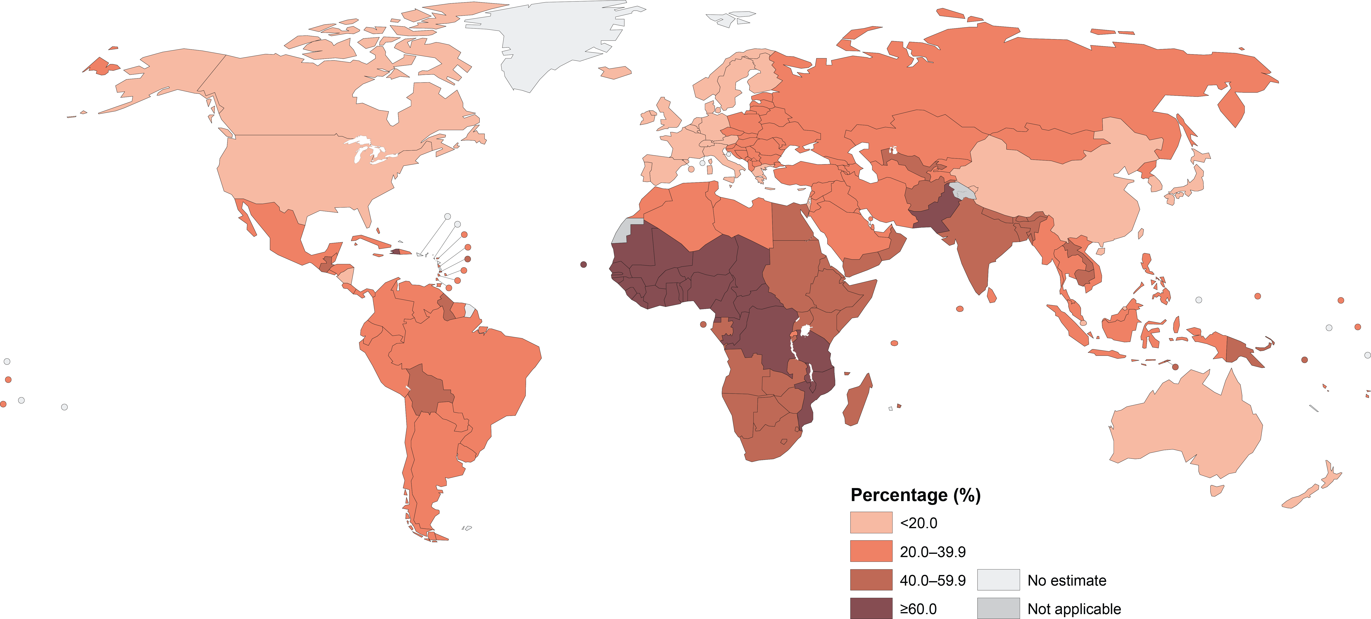
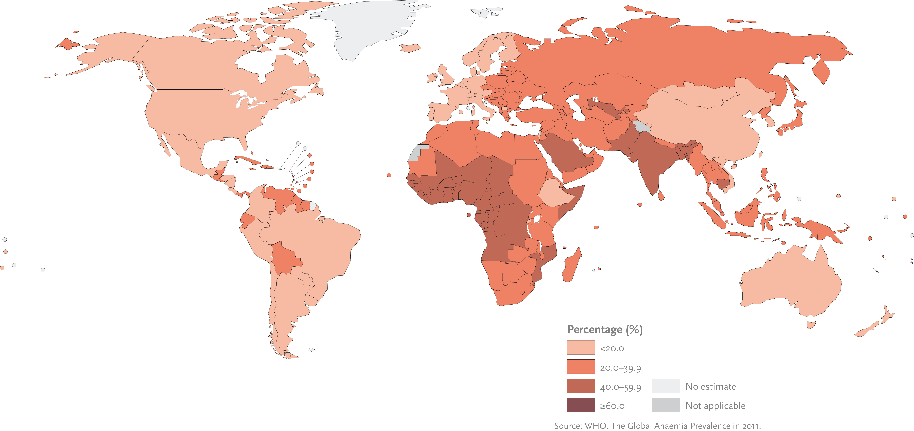
How widespread is the problem?
Anemia affects approximately a quarter of the world
Greatest burden in young children and women
Anemia Prevalence
Children 6-59 months
Pregnant women
Slide 5
WHO 2011
Notes:
Anemia affects a quarter of the global population, or a total of approximately 1·62 billion people, including 293 million children younger than 5 years and 468 million non-pregnant women.
Children and women of reproductive age (and especially pregnant women) are most at risk, with global anemia prevalence estimates of 47% in children younger than 5 years, 42% in pregnant women, and 30% in non-pregnant women aged 15–49 years.
Africa and Asia account for more than 85% of the absolute anemia burden in the high-risk groups.
Anemia is estimated to contribute to more than 115 000 maternal deaths and 591 000 perinatal deaths globally per year.

Slide 6
Interventions for Anemia
Supplementation
  Iron-folic acid (IFA) in pregnancy
  IFA for adolescent girls (age 15-19)
  IFA for women of reproductive age (age 15-49)
  Vitamin A supplementation
  Micronutrient powders (MNPs) for 6-23 mo. child
Fortification
  Mass fortification—flour (wheat and maize), salt, sugar, fats and oils, rice
Slide 6
Notes:
Supplementation
Iron–folic acid (IFA) supplementation during or before pregnancy can effectively reduce the risk of iron deficiency and anemia and improve gestational outcomes.
During pregnancy, women face increased iron requirements during pregnancy, and folic acid is necessary for the healthy development of the fetus. IFA supplementation is usually part of a comprehensive ANC package. The WHO recommends daily oral IFA supplementation in areas where anemia prevalence rates are above 20 percent and weekly IFA supplementation in areas where anemia is 20 or below.
Adolescent girls and women of reproductive age (WRA), IFA supplementation before pregnancy can improve birth outcomes, as it increases the iron and folic acid status in women pre-pregnancy, and addresses the iron deficiency during menstruation. WRA (including adolescents) can be given oral IFA supplementation for 3 consecutive months, daily or weekly, depending on the anemia prevalence rates in the setting.
In settings where vitamin A deficiency is a public health problem, the WHO recommends a high-dose vitamin A supplement every six months for children 6–59 months to reduce child morbidity and mortality. Note that high-dose vitamin A supplementation improves vitamin A status for only up to three months in children who have low dietary intake and it is insufficient for preventing vitamin A deficiency because it does not address the underlying cause of the deficiency.
Micronutrient powders, a mixture of vitamins and minerals, enclosed in single-dose sachets, which are stirred into a child’s portion of food immediately before consumption have been shown to reduce anemia and iron deficiency. Micronutrient powders contain a minimum of iron, vitamin A and zinc.
Fortification
Mass or industrial fortification refers to adding micronutrients and minerals to industrially processed and widely consumed edible products. Common fortified foods, for example, include salt, wheat and maize flours, fats and oils, and sugar, but can also include bouillon cubes or soy sauce. Foods fortified with iron will likely have the highest impact on anemia, although foods fortified with other nutrients, such as vitamin A and folic acid, may also be important.

Slide 7
Interventions for Anemia
Disease control
  Malaria—intermittent preventive treatment in pregnant women (IPTp), and malaria prevention with bednets (LLIN); indoor residual spraying; prompt diagnosis and treatment with anti-malarials
  Worm infections—deworming in pregnancy, age 1-5
  Common infectious diseases*
Delayed Cord Clamping
Slide 7
Notes:
Malaria
With IPTp, doses of sulfadoxine-pyrimethamine (SP) are given to pregnant women during antenatal care visits, regardless of malaria status, to clear existing parasites and prevent new infections. IPTp reduces risks of adverse maternal and fetal outcomes (reduction of maternal malaria episodes, maternal and fetal anemia, and low birthweight). Three or more doses of IPTp is the current WHO recommendation, with greater benefits than taking only one or two doses. Long-lasting insecticide-treated bed nets (LLINs), which are factory-treated to remain effective for a minimum of three years and 20 washes, are an effective way to curb malaria transmission in endemic areas. In malaria-endemic areas, all at-risk population groups should be covered with LLINs, especially children under 5 and pregnant women. Indoor residual spraying (IRS)- applying residual insecticides to indoor surfaces where it can repel and/or kill adult mosquitoes. Correct insecticide application can reduce mosquito populations, curbing malaria transmission and the contribution of malaria to anemia. In target areas, IRS coverage of 80 percent or more leads to the maximum protection for the population and can interrupt transmission in the immediate area. Prompt diagnosis and treatment with anti-malarials is an integral part of the national malaria control program in malaria-endemic countries. Untreated malaria can lead to severe anemia and death. Early diagnosis, prompt, effective treatment within 24–48 hours is critical.
Worm infections: In areas with endemic infection levels, periodic anthelminthic treatment or deworming is recommends for all at-risk population groups, using albendazole or mebendazole for helminths, or praziquantel for schistosomiasis. At-risk groups include preschool-age children, starting at 12 months of age; school-age children and women of reproductive age, particularly pregnant women after the first trimester; and lactating women.
Common infectious diseases: Prompt and appropriate treatment and/or management of common infectious diseases, including HIV and tuberculosis, is also key for anemia control, given that the inflammation that results from these infections can indirectly lead to anemia.
Delayed cord clamping: clamping the cord 1-3 minutes after delivery of the baby can prevent iron deficiency in the first six months of life.

Slide 8
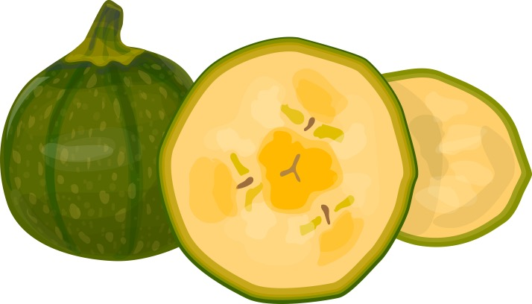



Interventions for Anemia
Dietary interventions: at household level
  Increase the variety and quantity of micronutrient-rich foods
Infant & young child feeding (IYCF): at household level
  Exclusive breastfeeding (EBF)
  Appropriate complementary feeding
©HarvestPlus: A woman harvests high iron beans in Northern Province, Rwanda. Photo: HarvestPlus/Angoor Studios - See more at: http://bit.ly/1JVO3W0
Slide 8
Notes:
Dietary interventions are interventions that change food consumption at the household level, such as increasing the consumption of animal-source foods. The objective in changing household diet is to increase the variety and quantity of micronutrient-rich foods in order to decrease micronutrient deficiencies. This can be done through social and behavior change activities, but can also include increased production of nutrient-rich foods and improved access to diverse foods.
Infant and young child feeding
WHO recommends early initiation of breastfeeding (within the first hour), exclusive breastfeeding for the first six months of life, and timely and appropriate complementary feeding, with continued breastfeeding up to two years or beyond. Exclusive breastfeeding reduces infant morbidity and mortality from common infections, such as diarrhea or pneumonia; and it indirectly reduces anemia by preventing the effects of inflammation.
Complementary feeding starts at 6 months of age when breastmilk alone cannot meet the nutritional requirements of an infant. The guiding principles of complementary feeding include (1) giving amounts of food that increase with the age of the child ; and (2) ensuring the food has the right consistency, nutrient, and energy density, and (3) the care provider practices responsive feeding. Ensuring dietary diversity in these early months of life when growth is rapid helps avoid micronutrient deficiencies.

Slide 9

Interventions for Anemia
Water, Sanitation & Hygiene (WASH) interventions—community intervention
  Safe, improved water supply
  Household treatment of water used for consumption
  Handwashing with soap and water
  Improved sanitation facilities
Family Planning: health facility based
  Birth spacing and counseling
Social and behavior change communication
Slide 9
Notes:
Water, Sanitation & Hygiene (WASH) interventions
Use of improved water sources, where the water comes from a known, uncontaminated origin, and is transported to household in a way that ensures it is always safe and available, can reduce the risk of acquiring waterborne infections. Improved drinking water sources include: including piped water, boreholes and tube wells.
Handwashing with soap and water for all household members at key times can eliminate, or greatly reduce, the risk of ingesting pathogens from the physical environment which can, in turn, decrease intestinal infections, inflammation of the gut, or micronutrient deficiencies.
Using improved sanitation facilities is an important way to stop the transmission by removing fecal matter from the environment, which prevents pathogens from entering waterways, household courtyard soil, and contaminating surfaces.
Family planning interventions include using modern contraceptive methods (including pills, condoms, injectables, implants and intrauterine devices) and counseling to space births or to limit the number of children. Delayed pregnancy improves birth outcomes, decreases pregnancy-related anemia risk, and allows women time to build up and maintain stores of iron and other micronutrients to prevent micronutrient deficiencies.
Social and behavior change communication should be an integral part of all the interventions discussed in this presentation. Each intervention should be accompanied by effective behavior change strategies to address social and cultural barriers for use and ensure sustained use.

Slide 10
Thank you!
Notes:
Any questions?

